Slide 1
Cancer
Lesson 2.4
How are cell activities controlled in a normal cell and disrupted in cancer?

Slide 2
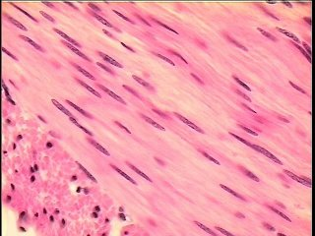
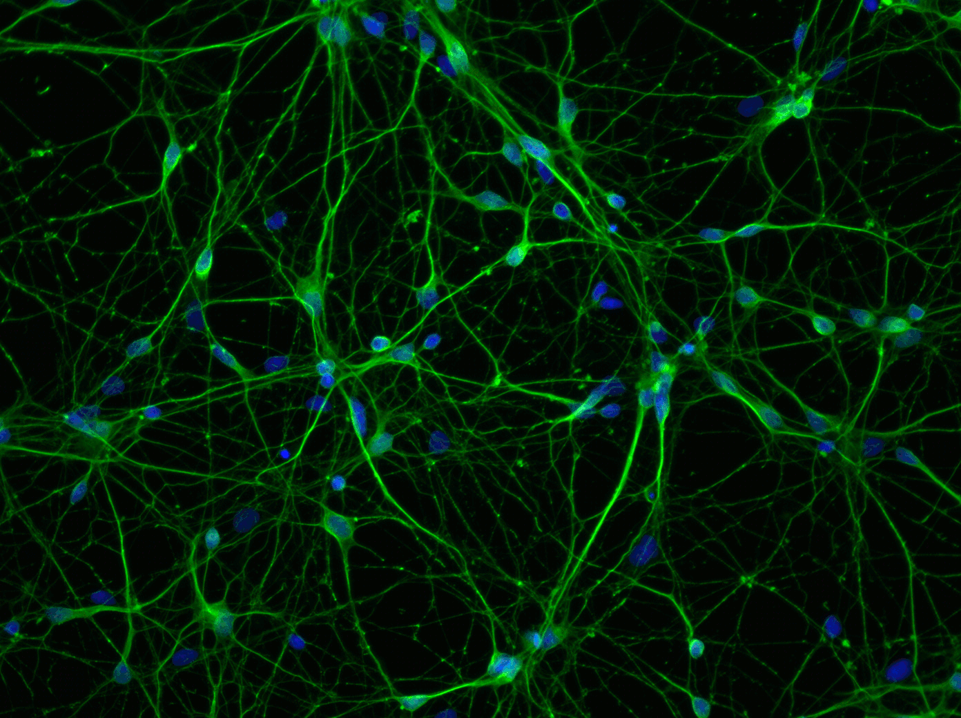
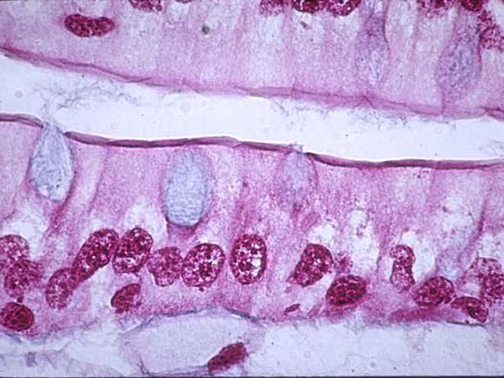
Do Now
All the cells in our body have the same DNA, yet you have:
Muscle Cells
Neurons
Lung Epithelial Cells
How is this possible?

Slide 3
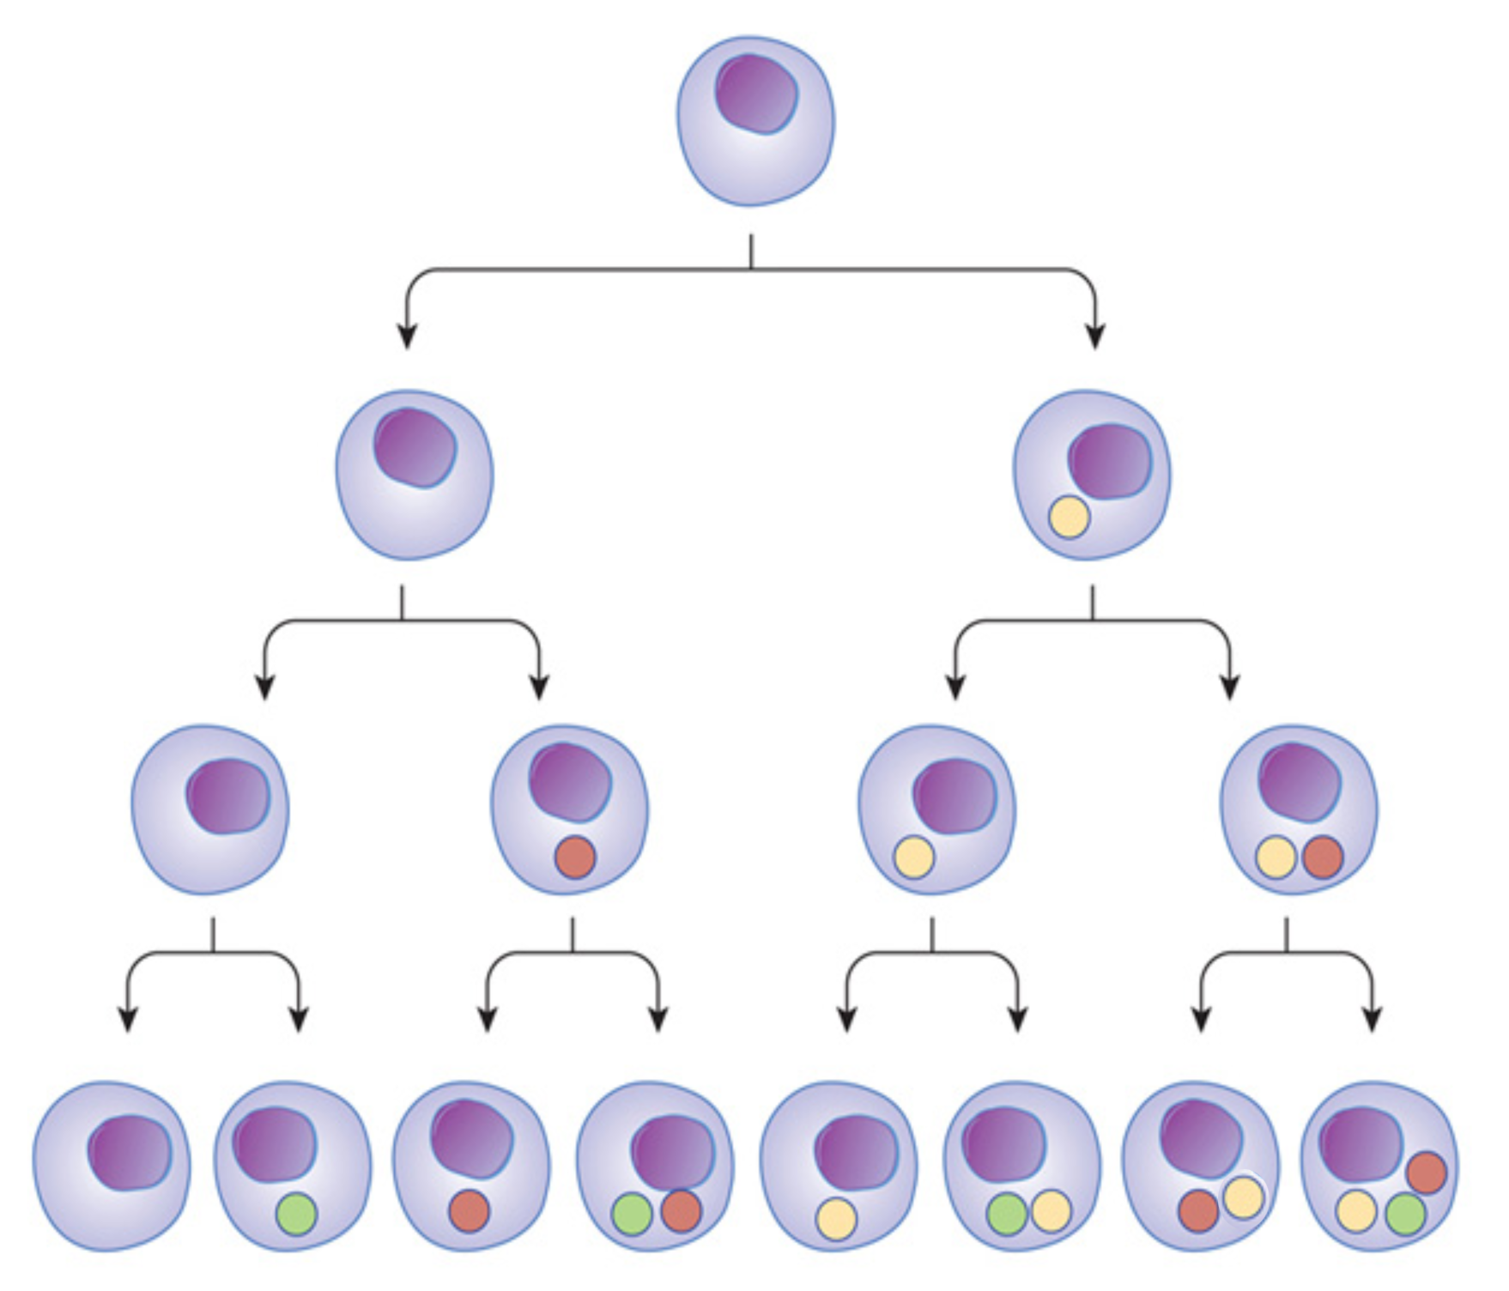
Cells specialize like we do!
Baby
High School Student
Art School Student
Law Student
Artist
Lawyer

Slide 4
Stem Cells are like “Babies”
Replicate to produce daughter stem cells
A stem cell
can……..
Specialize or differentiate into many cell types

Slide 5
Once cells specialize, they become ‘terminally differentiated’
Columnar Epithelial Stem Cell
Terminally Differentiated Lung Cell
Epithelial Stem Cell
Stem Cell
High school student
Law student
Baby
Lawyer
More Specialized

Slide 6
Specialization is a trade-off for growth
Terminally differentiated means that the cell is completely specialized, and no longer replicates.
Terminally Differentiated Lung Cell
More Specialized

Slide 7
In most cases, a terminally differentiated ‘lawyer cell’ can’t become an ‘artist cell’
A lawyer might be able to paint, but because he/she is a lawyer…
He/she will paint like a lawyer, not an artist!

Slide 8
How do cells specialize?
Red blood cell
Muscle cell
Pancreatic cell
Neuron

Slide 9
Cells specialize based on the genes they express

Slide 10
How do cells determine which genes to express?
Transcription factors
‘Opening’/ ‘closing’ of DNA

Slide 11
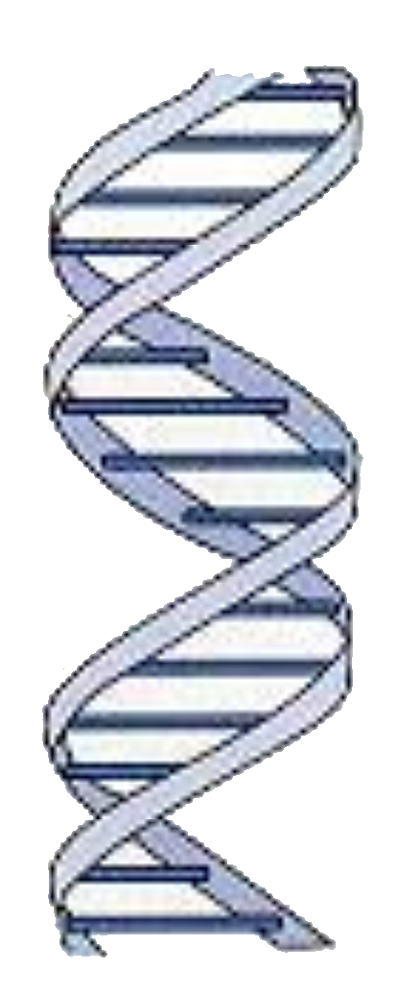
A quick review of molecular dogma
Transcription
Translation
DNA
(coding for a gene)
RNA
Protein

Slide 12
Cells specialize by producing specific sets of proteins
This is called gene expression

Slide 13
Transcription factors control gene expression
Genes that encode those proteins are turned ON by specific transcription factors (TF)
T F
Transcription and Translation
Protein
Gene

Slide 14
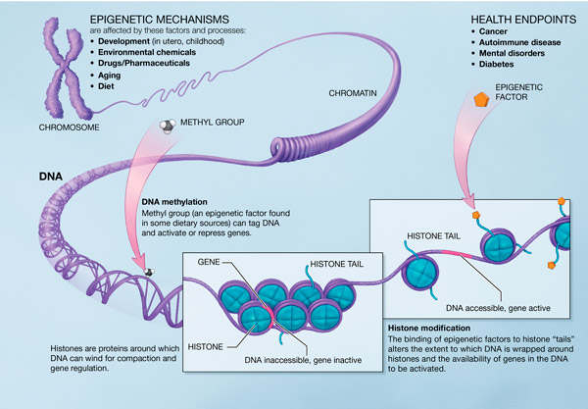
But transcription factors need DNA to be ‘open’ to turn genes ON
Normally DNA is tightly wound around histone proteins.
Transcription factors can’t bind to tightly wound ‘closed’ DNA.
Transcription factors can only bind to loosely wound ‘open’ DNA.
Chromosome
DNA
Gene
Histone
DNA tightly wound, not expressed

Slide 15
DNA ‘opening’ is regulated by modifying the histones
Gene
Histone
Acetyl group
DNA tightly wound
DNA loosely wound
This is called ‘epigenetic regulation’ of gene expression
Notes:
“Why do you think histone acetylation is called ‘epigenetic regulation’?”
• Because it is a way to regulate gene expression that doesn’t depend on the gene DNA.
Ask students: “Why is epigenetic regulation important?”
• Because it allows individual cells to switch genes on and off.

Slide 16
How does DNA ‘open’ for expression?
Gene
Histone
DNA tightly wound, not expressed
Acetyl group
DNA loosely wound
Adding an acetyl group to the histone loosens its grip on DNA.
The DNA unwinds from the histone, revealing genes.
Genes can now be expressed.

Slide 17
‘Closing’ DNA stops gene expression
Gene
Histone
Methyl group
DNA tightly wound
Adding a methyl group to the histone or the DNA tighten their grip on each other.
The DNA winds up tightly, hiding the genes.
Gene can no longer be expressed.
Notes:
This slide introduces another way genes can be epigenetically regulated. In this case a methyl group can be added to either the histone or the DNA.
Ask students: “If the histone protein can be either acetylated or methylated what would you predict methylation does?”
• Methylation inhibits gene transcription.
2
Ask students: “Why do you think methylation is important in stem cell differentiation?”
• Methylation will allow the genes responsible for replicating stem cells to be shut off so they can
now produce a more differentiated phenotype.

Slide 18
How would ‘closing’ DNA stop our ‘lawyer cell’ from becoming an ‘artist cell’?

Slide 19
Activity:
What genes are ‘opened’ and ‘closed’ in our cells?

Slide 20
Wrap Up: DNA in cancer cells tends to be in the ‘open’ state
Gene
Histone
Methyl group
Acetyl group
DNA tightly wound
DNA loosely wound
In healthy cells, most proto-oncogenes are usually wound onto histones – so they will not be expressed.
But cancer cell DNA is often ‘open’ - proto-oncogenes can be expressed when they shouldn’t be .

Slide 21
Specialization is normally a one way trip!
Normal cells
Baby
Cancer cells
High School Student
More specialized
Divides less
Less Specialized
Divides more
Art
Student
Law
student
Artist
Lawyer

Slide 22
Cancer cells behave like stem cells
Cancer cells lose their specialized functions –
Genetic changes - mutated genes are expressed when they shouldn’t be.
Epigenetic changes – open DNA means genes can be expressed at the wrong time.
So cancer cells behave more like stem cells than specialized cells.

Slide 23
Homework
Read workbook chapter 2.4 and answer the question.

